Slide 1
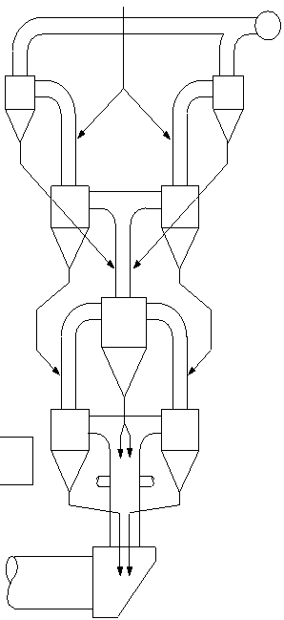
Info Card - Build-Up Location and Pressure Loss
Kiln 1 & 2
Coating formation mainly in the cyclone cones of stage 3 and 4
Clogging of meal outlet of stage 3 and 4
More than 70% of all cyclone blockages occurred in stage 4
High pressure loss over riser (10 mbar)
Heavy build-up formation in the riser duct and kiln inlet
3
4
4
1

Slide 2
Info Card - Design
Small meal outlet of the cyclones (meal ducts), mainly in stages 3 and 4
In the preheater tower, some of the meal flaps were fixed in open position with a metallic wire to prevent that blocks of coating would get stuck there.
Small kiln inlet chamber. Velocities of up to 30 m/s at critical kiln inlet cross section.
Inadequate design of top stage cyclones dust loss of 26.6 t/h (13,7% on kiln feed)
2

Slide 3
Info Card - Kiln Speed
The kiln is operated at 2.1 rpm (3.0 rpm installed). The clinker microscopy shows, that the clinker has a too high retention time in the high temperature zone of the kiln (large alite crystal size).
3

Slide 4
Info Card - Free Lime
Low clinker free lime values indicate a hard burning:
CaO_{free}: 0.6%
4

Slide 5
Info Card - AFR
TSR = 9%
High liquid AF feed rate fluctuations as well as fluctuations of the calorific value lead to an unstable kiln operation
5

Slide 6
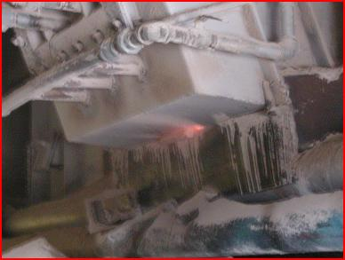
Info Card - False Air I
The kiln inlet seal does not seal properly
False air intake at splash box of riser duct, false air at poke holes, inspection doors (often not closed).
6

Slide 7
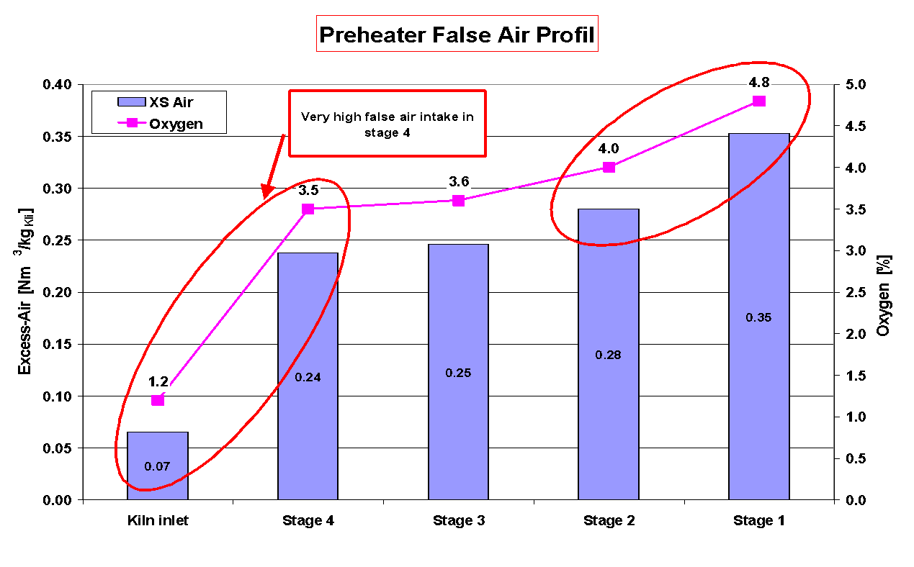
Info Card - False Air II
7

Slide 8
Info Card - Alkali/Chlorine/Sulfur Balance
 | SO₃ | K₂O | Na₂O | Cl
Total input (%cli) | 0.99 | 0.60 | 0.33 | 0.027
Total output (%cli) | 1.05 | 0.62 | 0.31 | 0.023
Hot meal (%) | 4.3 | 2.8 | 0.37 | 1.4
LOI: 24%
Sulfur volatility: 0.81
A/S ratio in clinker: 0.88
8

Slide 9
Info Card - Hot Meal
Hot Meal Evaluation
Hot Meal Evaluation
3.0
frequent
Kiln 1
2.8
blockages
2.6
2.4
2.2
2.0
1.8
% Cl
1.6
1.4
1.2
zone of increasing
1.0
encrustation
0.8
problems
0.6
0.4
no encrustations
0.2
0.0
0.0
0.5
1.0
1.5
2.0
2.5
3.0
3.5
4.0
4.5
5.0
5.5
6.0
% SO3
9

